Slide 1
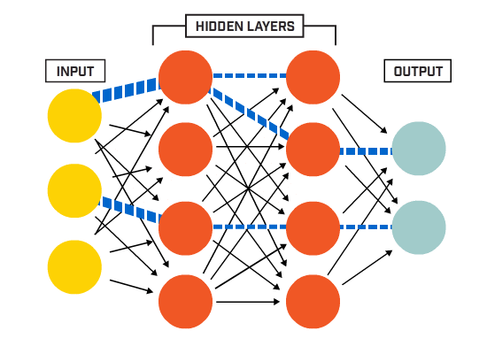
ARTIFICIAL NEURAL NETWORK AND DEEP LEARNING
Dr. Somesh Nandi
Dept of AIML
RVCE

Slide 2
Unit -1
Neural Networks
What is NN
Models
Neural networks as directed graphs
Architectures
Learning Processes
Different Types of Learning Process
Learning with and without teacher
Learning tasks
Memory and adaptation
Statistical Learning

Slide 3
Unit -1
Neural Networks
A Neural network is a massively parallel distributed processor made up of simple processing units which has a natural propensity for storing experiential knowledge and making it available for use. It resembles human brain in two aspects
Knowledge is acquired by the network from its environment through a learning process
Interneuron connection strengths known as synaptic weights are used to store the acquired knowledge
Procedure to perform the learning process is called learning algorithm

Slide 4
Unit -1
Benefits of Neural Networks
Neural Networks achieve power through
Massively Parallel and Distributed Structure
Generalization – refers to produce reasonable outputs for inputs not encountered in training
Properties of Neural Networks
Non Linearity -- Neurons are distributed throughout the network
Input – Output Mapping -- Reordering of previously trained examples and mapping Input – output using estimation statistics
Adaptivity -- Adapt to the Surrounding Environment
Evidential Response -- Decision and Confidence , rejection of unwanted patterns
Contextual Information – Every neuron is affected by the activity of global neurons
Fault Tolerance -- hardware is fault tolerant, robust in nature , performance degrades in adverse conditions, but not catastrophic failure
VLSI Implement ability -- well suited due to massive parallelism
Uniformity of Analysis and Design -- commonality, share and integrity
Neurobiological Analogy

Slide 5
Unit -1
Models of a Neuron
Synapses are the connecting junction between axon and dendrites. The majority of synapses send signals from the axon of a neuron to the dendrite of another neuron
Dendrites have fibers branching out from the soma in a bushy network around the nerve cell.
Dendrites allow the cell to receive signals from connected neighboring neurons and each dendrite is able to perform multiplication by that dendrite’s weight value
Axons are the single, long fibers extending from the main soma.
The axon will branch and connect to other dendrites

Slide 6
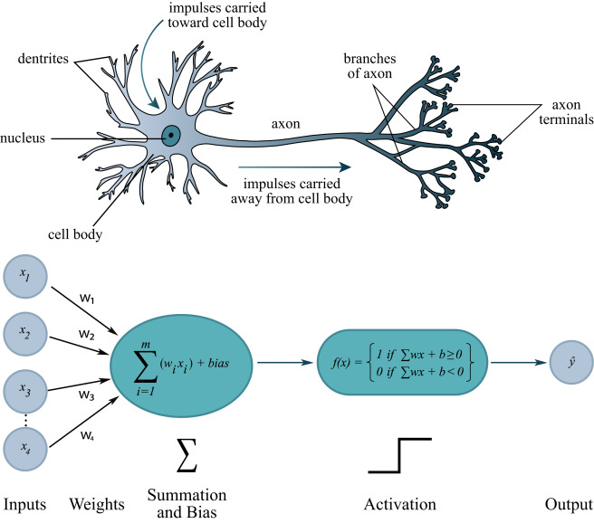
Unit -1
Cell – Neuron
Dendrites –Weight or interconnections
Soma – Net Input
Axon –Output

Slide 7
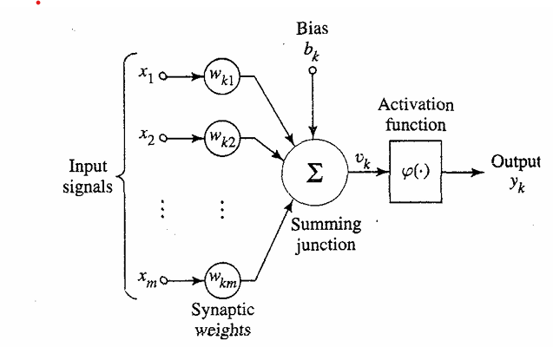
Unit -1
Non Linear Model of a Neuron

Slide 8
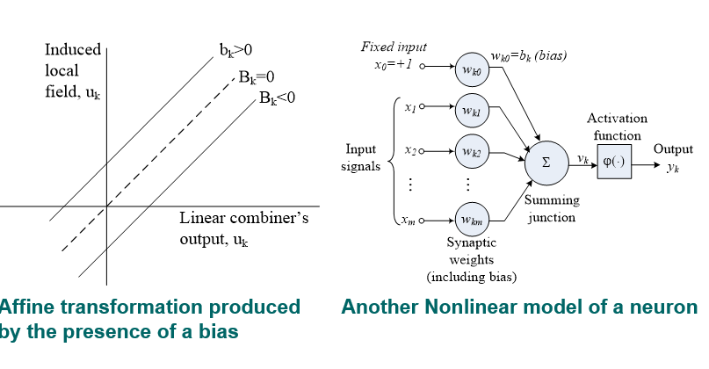
Unit -1
Non Linear Model of a Neuron

Slide 9
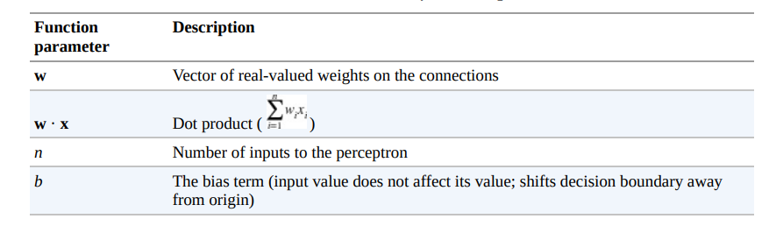
Unit -1
Functional Parameters of a Neuron

Slide 10
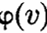
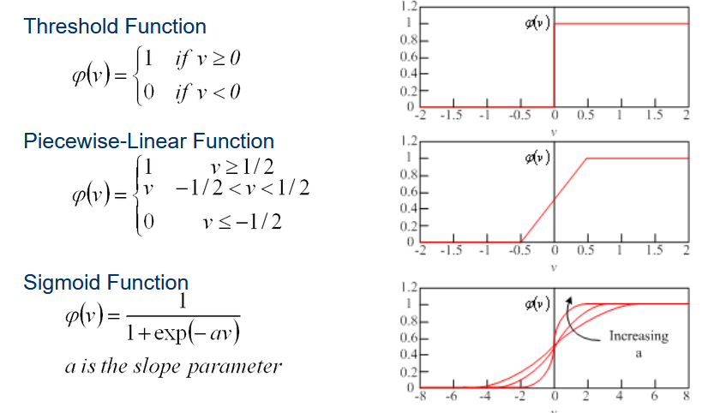
Unit -1
Activation Function denoted by defines the output of a neuron in terms of induced local field
Notes:
a is the slope parameter of the sigmoid function

Slide 11
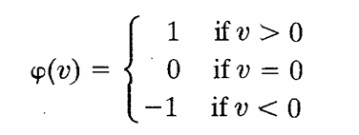
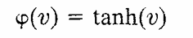
Unit -1
Signum Function : Activation function ranging from -1 to +1 where the activation function assumes an antisymmetric form with respect to origin, the threshold can be defined as
The hyperbolic tangent function of the same can be defined as

Slide 12
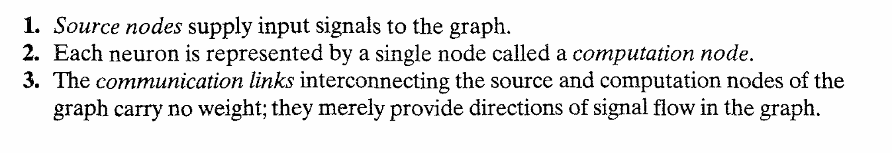
Unit -1
Neural Networks as Directed Graphs – Signal Flow Diagrams
Block diagram providing functional description of the network
Signal Flow graph providing a complete description of signal flow in the network
Architectural graph describing the network layout
Description of the graph

Slide 13
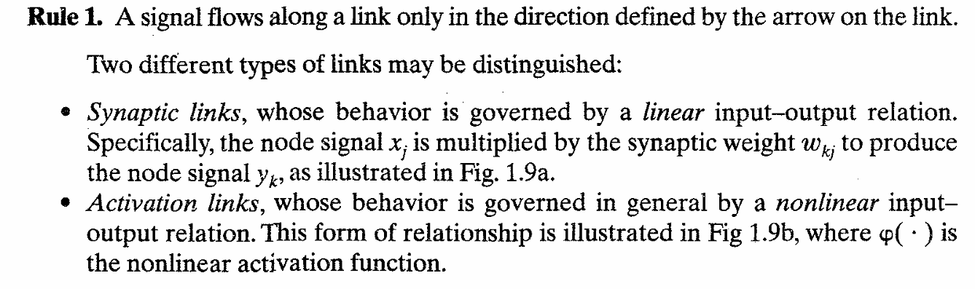
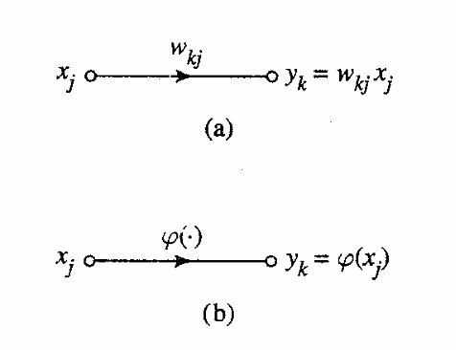
Unit -1
Neural Networks as Directed Graphs – Signal Flow Diagrams

Slide 14
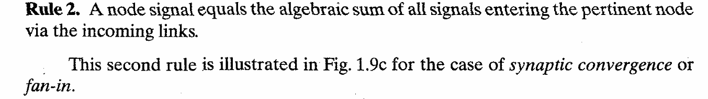
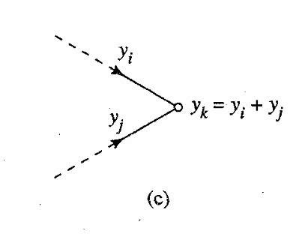
Unit -1
Neural Networks as Directed Graphs

Slide 15
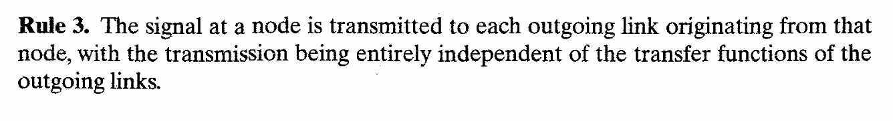
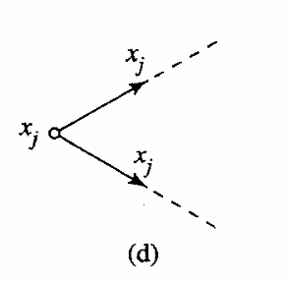
Unit -1
Neural Networks as Directed Graphs
This graph illustrates the synaptic divergence or fanout

Slide 16
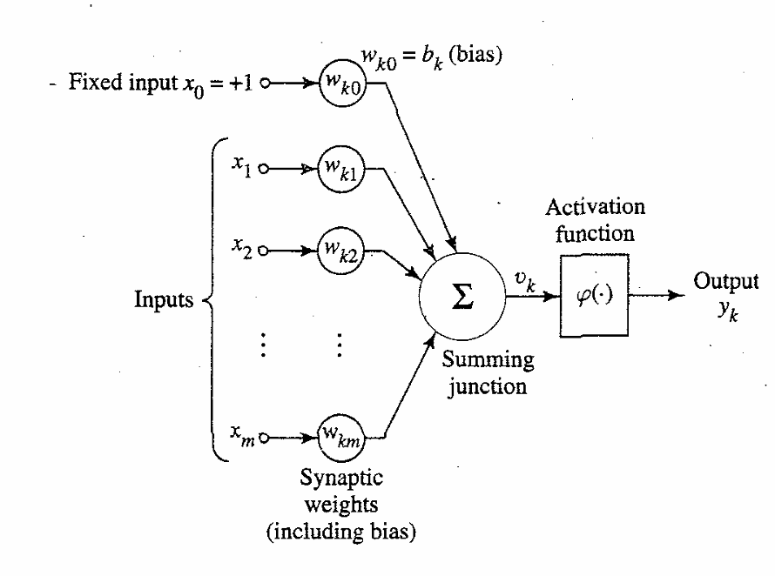
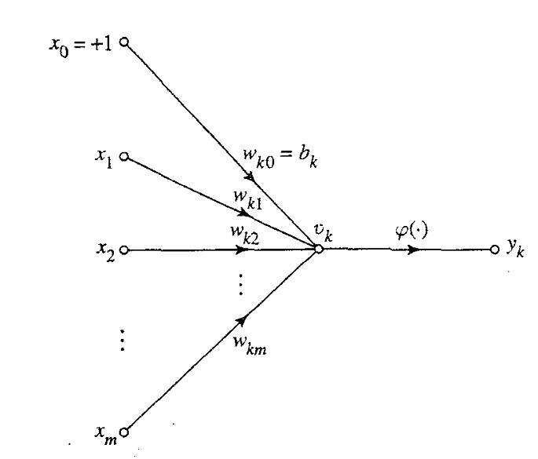
Unit -1
Neural Networks as Directed Graphs
Neural Network Diagram
Signal Flow Diagram

Slide 17
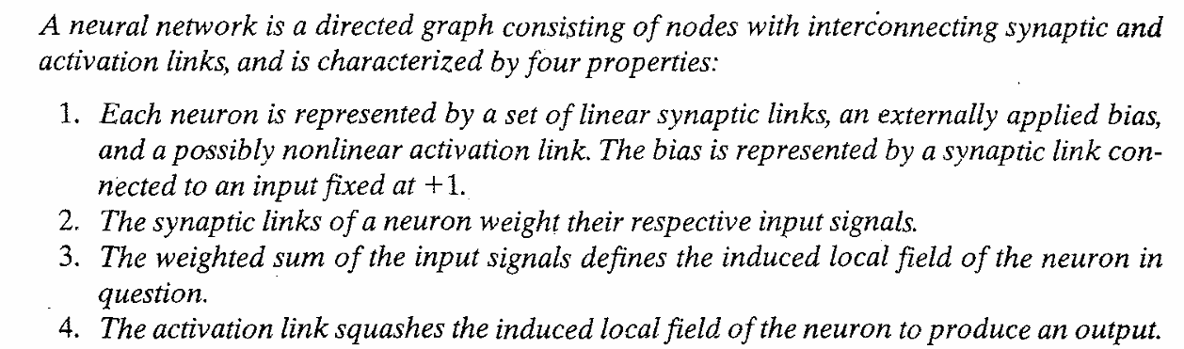
Unit -1
Neural Networks as Directed Graphs
Mathematical definition of a NN

Slide 18
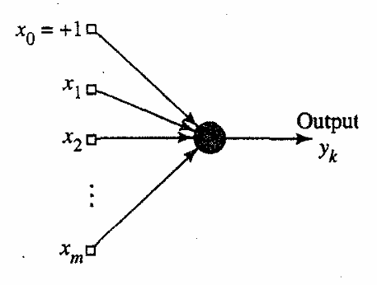
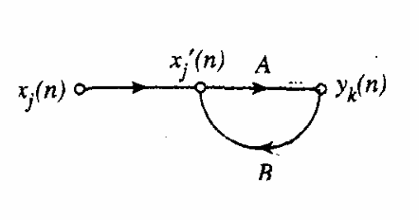
Unit -1
Feedback
Feedbacks are special class of neural networks called as Recurrent Neural Networks (RNNs)
Architectural Graph Signal Flow Graph

Slide 19
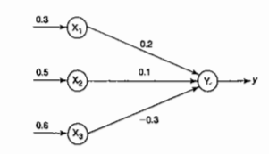
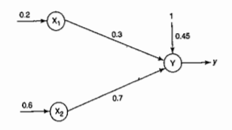
Unit -1
Problems
For the given network, calculate the net input to the output neuron
Calculate the net input (i) Without bias and (ii) when the bias is 0.45 and observe the difference and discuss

Slide 20
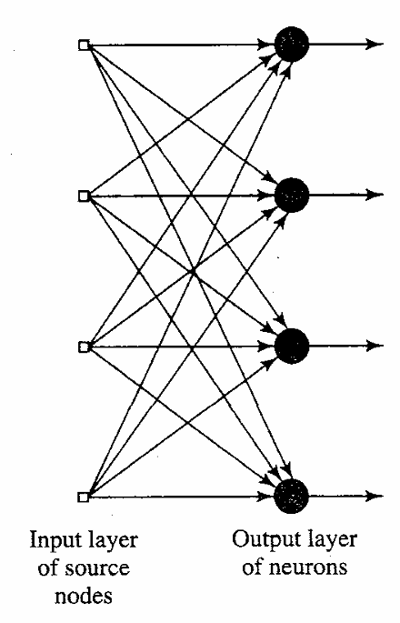
Unit -1
Network Architeures
Single Layer Feedforward network
Consists of input layer of source nodes that projects to output layer of computation node
Strictly feedforward or acylic type
Single output layer of computation nodes
Layer is formed by taking a processing element and combining it with other processing elements
Interconnections lead to the formation of various network architectures

Slide 21
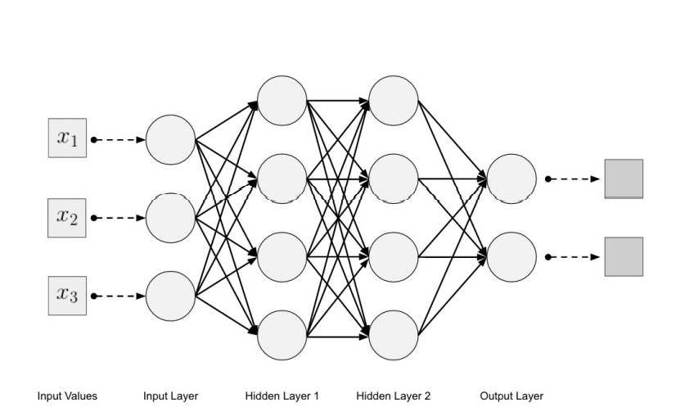
Unit -1
Network Architeures
Multi Layer Feedforward network

Slide 22
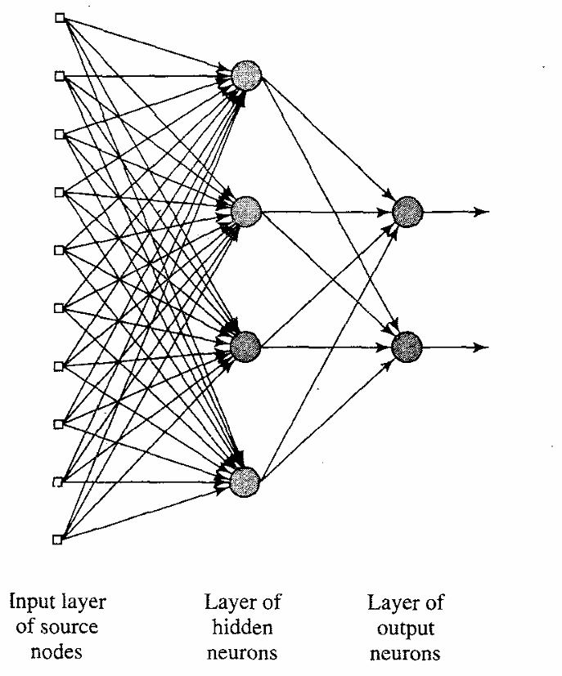
Unit -1
Network Architeures
Multi Layer Feedforward network
Consists of input layer , hidden layer
and output layer
Each layer can have a different number of neurons and each layer is fully connected to the adjacent layer.
The connections between the neurons in the layers form an acyclic graph

Slide 23
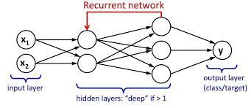
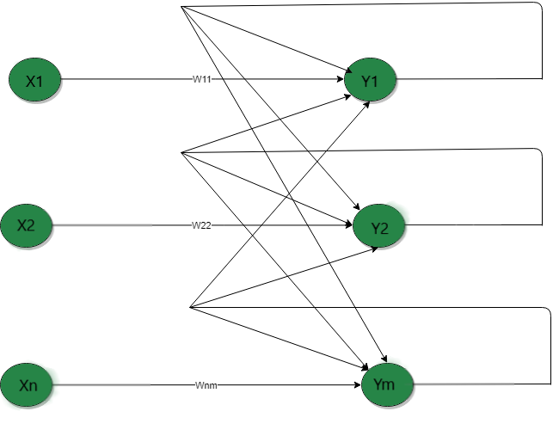
Unit -1
Recurrent Neural Network(RNN) - the output from the previous step is fed as input to the current step.
Single Layer Recurrent Network
Multi Layer Recurrent Network

Slide 24
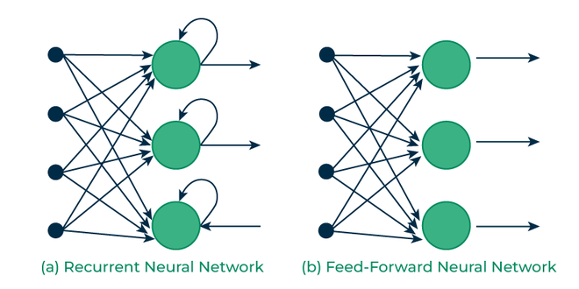
Unit -1
Recurrent Neural Networks Vs Feed forward Networks

Slide 25
Unit -1
Learning Process
Error Correction Learning
Memory Based Learning
Hebbian Learning
Competitive Learning
Boltzmann Learning
Learning with Teacher
Learning without Teacher

Slide 26
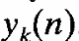
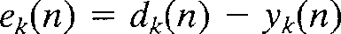
Unit -1
Error Correction Learning
Consider a simple case of a neuron k constituting the only computational node in the output layer of a feedforward neural network
Neuron k is driven by a signal vector x(n) produced by one or more hidden layers
Hidden layers are driven by an input vector applied from source node
The argument n denotes the discrete time , the time step of an iterative process involved in adjusting the synaptic weights of neuron k
The output signal of the neuron k is denoted by .
The output signal is comparted to desired response or target output dk(n).
An error correction an error signal, denoted by ek(n), is produced

Slide 27
Unit -1
Types of Learning
Error Correction Learning - Example
The error signal ek(n) actuates a control mechanism, apply a sequence of corrective adjustments to the synaptic weights of neuron k.
The corrective adjustments are designed to make the output signal Yk(n) come closer to the desired
response dk(n) in a step-by-step manner. This objective is achieved by minimizing a cost function or index of performance dk(n),defined in terms of the error signal ek(n

Slide 28
Unit -1
Types of Learning
Error Correction Learning - Example
The error signal ek(n) actuates a control mechanism, apply a sequence of corrective adjustments to the synaptic weights of neuron k.
The corrective adjustments are designed to make the output signal Yk(n) come closer to the desired
response dk(n) in a step-by-step manner. This objective is achieved by minimizing a cost function or index of performance dk(n),defined in terms of the error signal ek(n

Slide 29
Unit -1
Types of Learning
Hebbian Learning
Properties of Hebbian Synapse
Time Dependent Mechanism
Local Mechanism
Interactive Mechanism
Conjunctional or correlational Mechanism

Slide 30
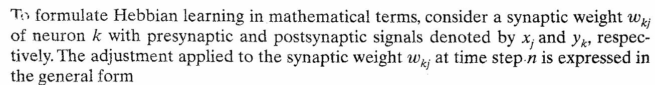
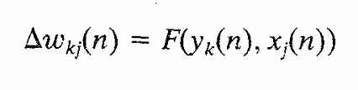
Unit -1
Types of Learning
Mathematical Model of Hebbian Network
Form 1:
* Also referred as activity Product Rule

Slide 31
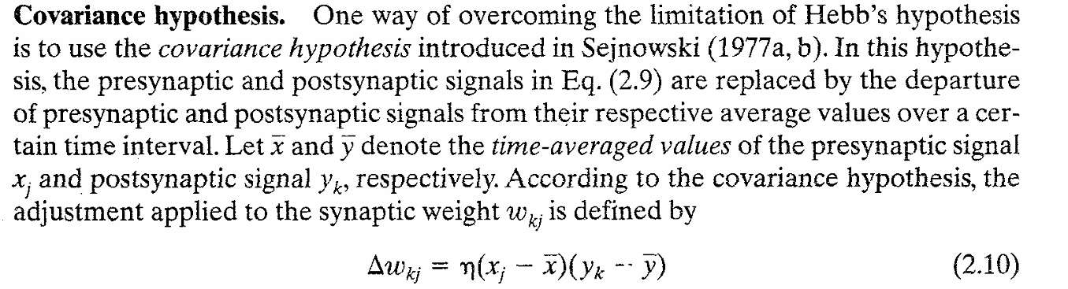
Unit -1
Types of Learning
Dis advantage of Hebb's Hypothesis
The repeated application of the input signal (presynaptic activity) xj leads to an increase in yk and therefore exponential grown that drives the synaptic connection into saturation
No information will be stored in synapse and the selectivity is lost
Form 2 :

Slide 32
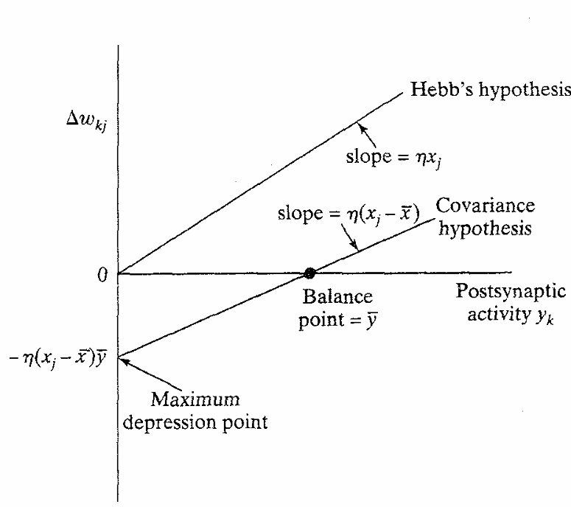
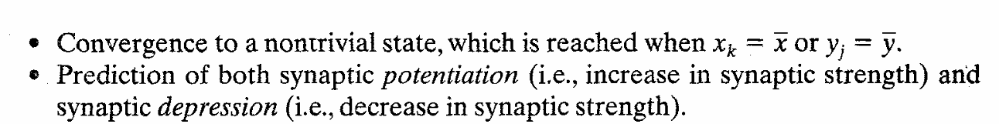
Unit -1
Types of Learning
Form 2 :

Slide 33
Unit -1
Types of Learning
Form 2 :

Slide 34
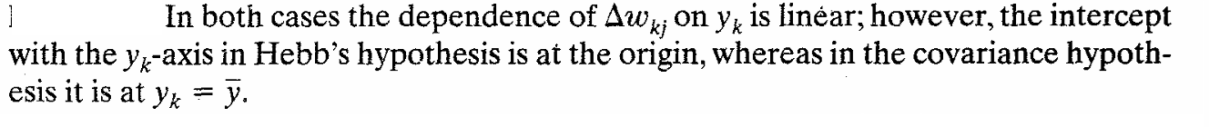
Unit -1
Types of Learning
Difference between Hebb’s and Covariance hypothesis:

Slide 35
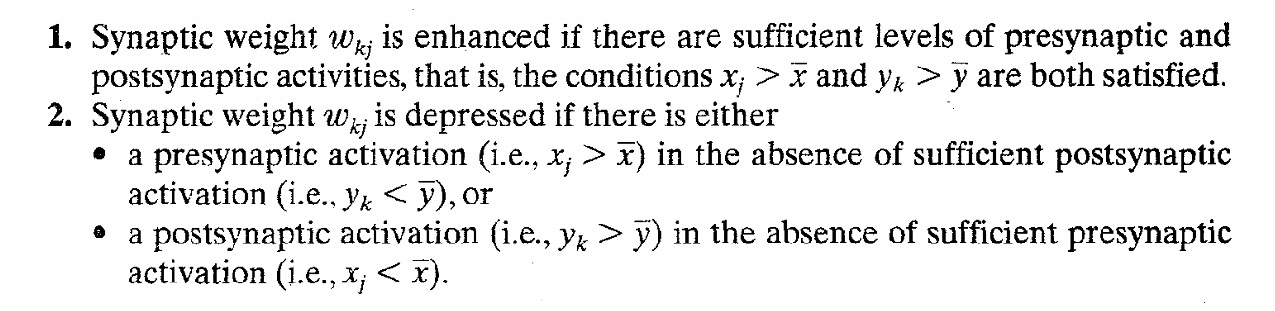
Unit -1
Types of Learning
Observations from eqn 2.10

Slide 36
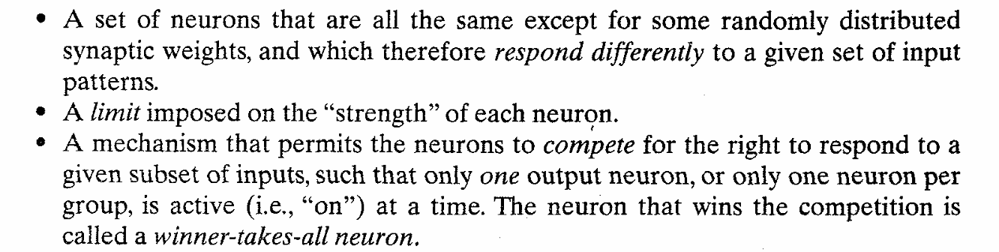
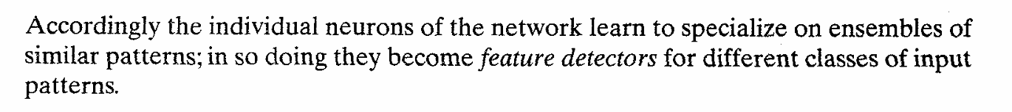
Unit -1
Types of Learning
Competitive Learning
Basic Elements of Competitive Learning

Slide 37
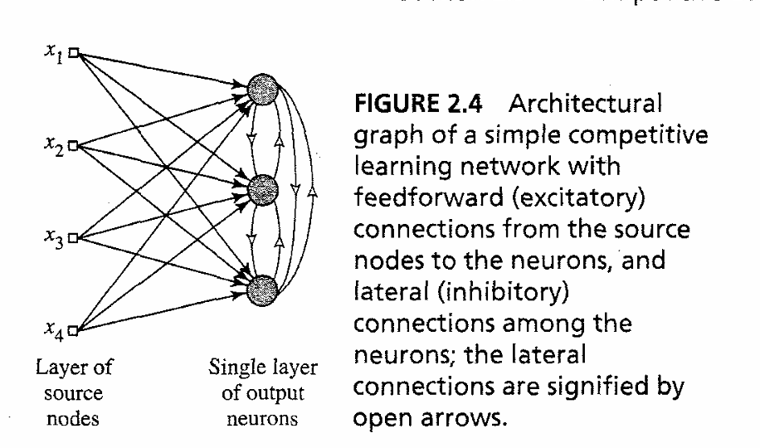
Unit -1
Types of Learning
Competitive Learning

Slide 38
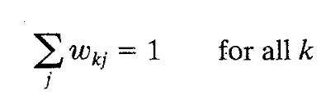
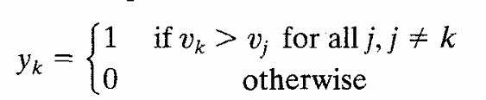
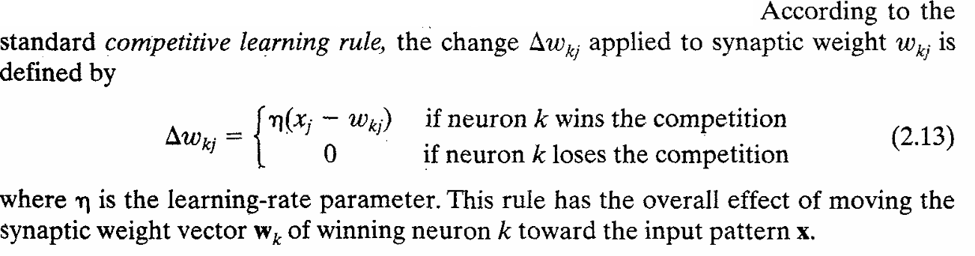
Unit -1
Types of Learning
Competitive Learning
Single Layer of output neurons each is connected to input nodes
May include feedback connections among neurons
Preform lateral inhibition with each neuron tending to inhibit the neuron that is laterally connected

Slide 39
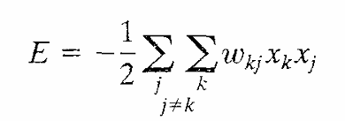
Unit -1
Types of Learning
Boltzmann Learning
Neural network built in the name of Boltzman is called as Boltzmann Learning
The neurons constitute a recurrent structure and operate in binary manner
They are either in “on” state or “off” state.
The energy function is given by
where xj is the state of the neuron j and wkj is the synaptic weight connecting neuron j to k.

Slide 40
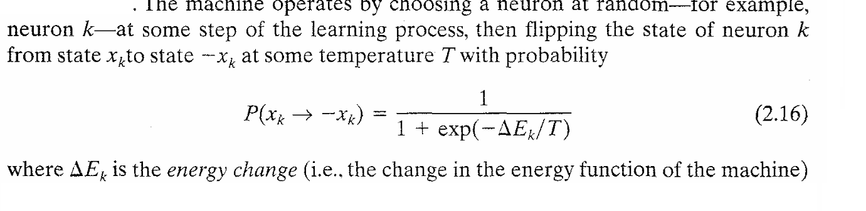
Unit -1
Types of Learning
Boltzmann Learning

Slide 41
Unit -1
Types of Learning
Boltzmann Learning – two functional groups : visible and hidden
Visible neurons provide an interface between the network and the environment which it operates
Hidden neurons always operate freely
Two modes of operation
Clamped Condition – in which visible neurons are all clamped onto specific states determined by environment
Free running condition : in which all neurons are allowed to operate freely

Slide 42
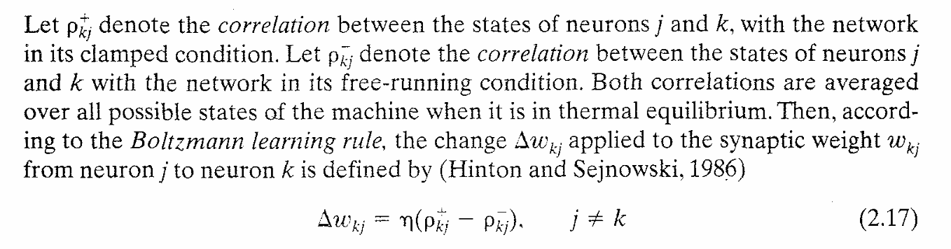
Unit -1
Types of Learning
Boltzmann Learning – two functional groups : visible and hidden

Slide 43
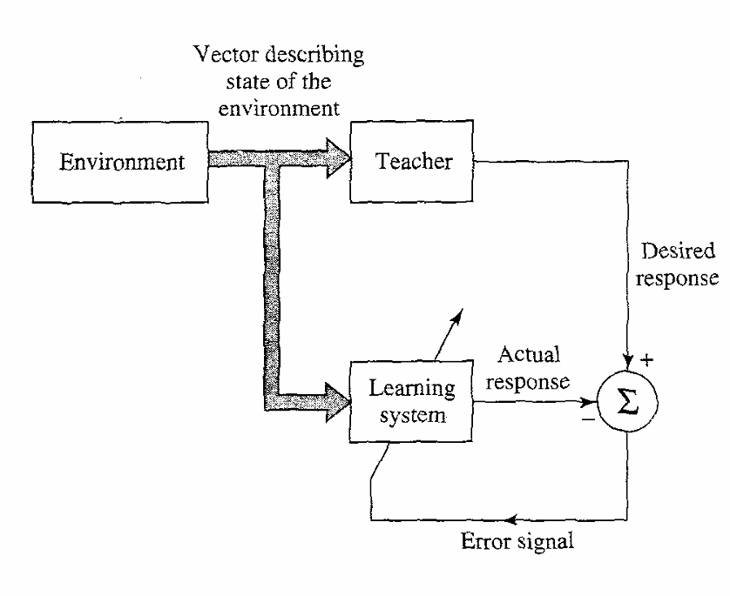
Unit -1
Types of Learning
Learning with a Teacher

Slide 44
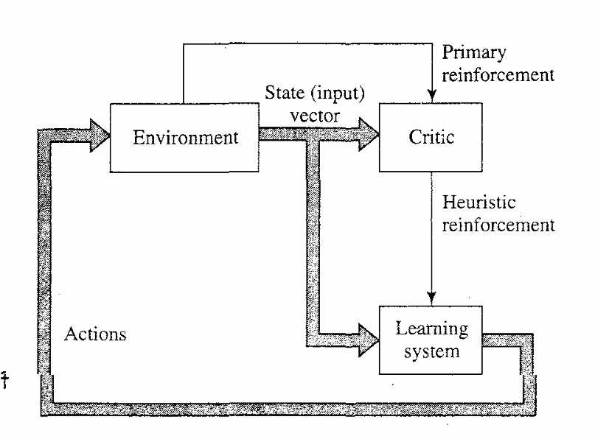
Unit -1
Types of Learning
Learning without a Teacher
Reinforcement Learning

Slide 45
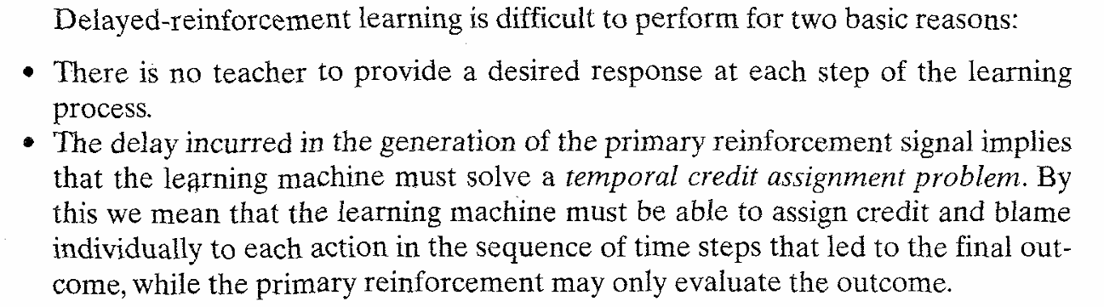
Unit -1
Types of Learning
Reinforcement Learning
The system is designed to learn under delayed reinforcement , ie the system observes a temporal sequence of stimul recd from environment
Goal of learning is to minimize a cost-to-go function , defined as the expectation of cumulative cost of actions taken over a sequence of steps instead of immediate cost

Slide 46

Unit -1
Types of Learning
Unsupervised Learning
Project Title
Project Title Project Title

Slide 47

Adaptive Filter Problem

Slide 48


Slide 49

Project Title

Slide 50


